Slide 1
Software Requirement Engineering
CSE-305
Dr Ghulam Rasool

Slide 2
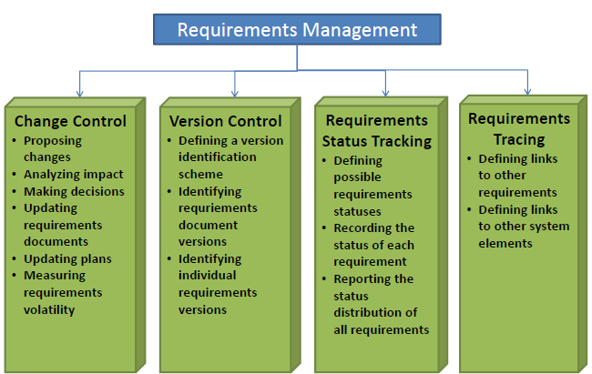
Requirements Management
The process of managing changes to the requirements for a system
Reasons for changes in requirements and how to manage them

Slide 3
Requirements Management
Requirements management encompasses the activities involved in
requesting changes to the baselined requirements,
performing impact analysis for the requested changes,
approving or disapproving changes,
implementing the approved changes
Measure the progress
Managing the logical links between individual requirements and other project work products

Slide 4
Requirements Baseline
Set of functional and non-functional requirements that the development team has committed to implement in a specific release
Subsequent changes can be made only through the project's defined change-control process

Slide 5
Requirements Management and Traceability
Requirements cannot be managed effectively without requirements traceability
A requirement is traceable if you can discover who suggested the requirement, why the requirement exists, what requirements are related to it and how that requirement relates to other information such as systems designs, implementations and user documentation
A requirement is traceable if and only if the origin of each of component requirements is clear
Traceability is key to impact, derivation and coverage analysis

Slide 6
Change - A Constant
There is nothing permanent except change
Heraclitus (500 B.C.)
No matter where you are in the system life cycle, the system will change, and the desire to change it will persist throughout the life cycle
Change always has a price
Knowledge of knowing more about things motivates us for changes.

Slide 7
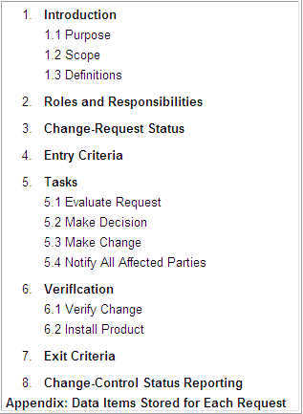
Change Control Process

Slide 8
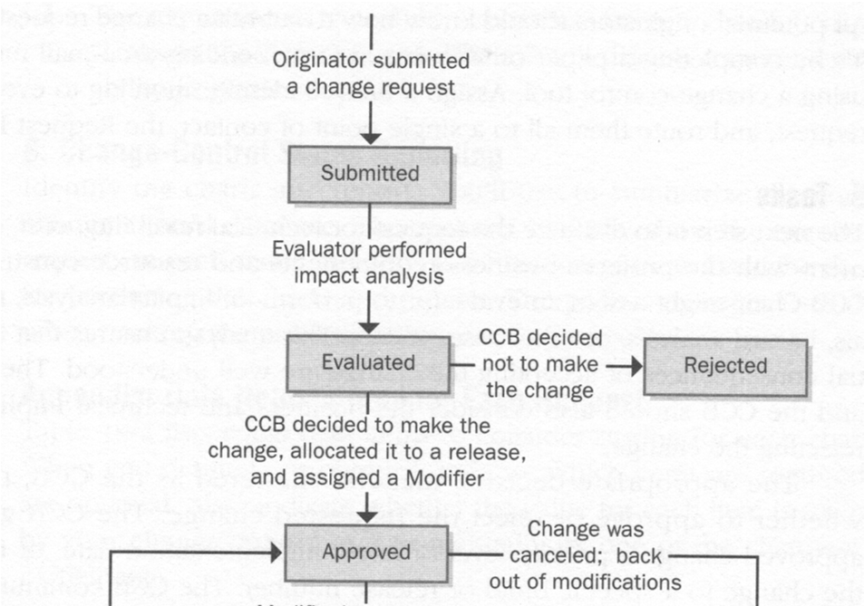
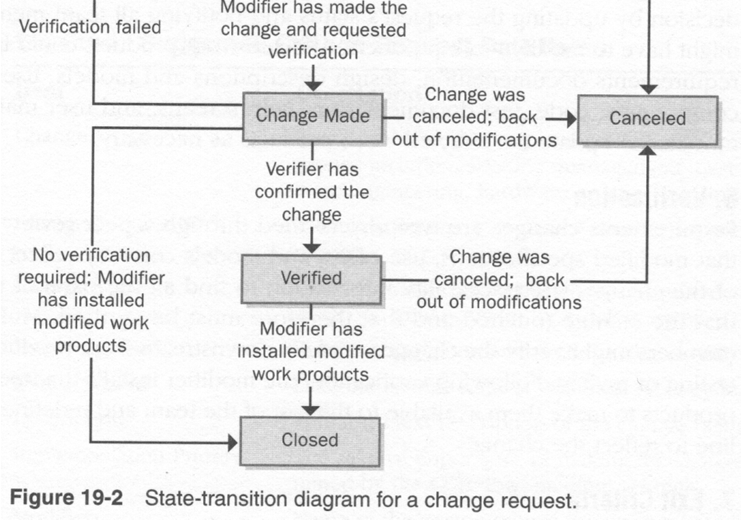

Slide 9
Change Management
Different types of analysis are used by members of CCB to support change management
Impact Analysis determine the financial resource or cost of change request to new feature. What if this were to change?
Derivation analysis answers that “Why is this here”? It focus on discovering the origin or rationale of a function/module
Coverage analysis is used as measure of progress and answers “Have I covered everything”. It is used for management reporting.

Slide 10
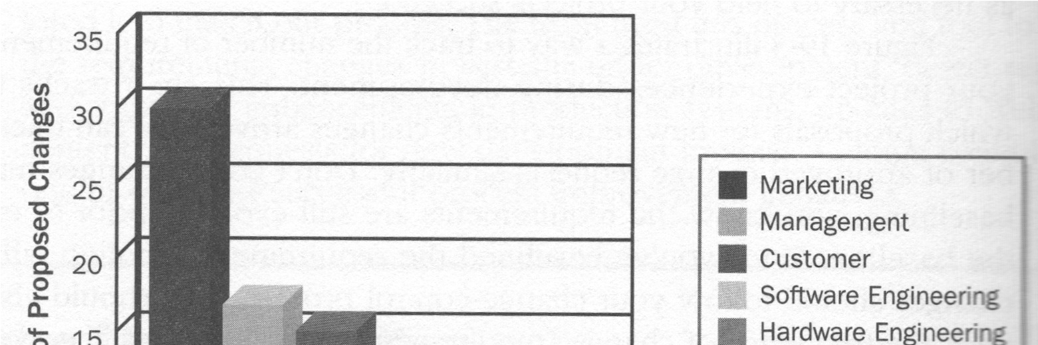
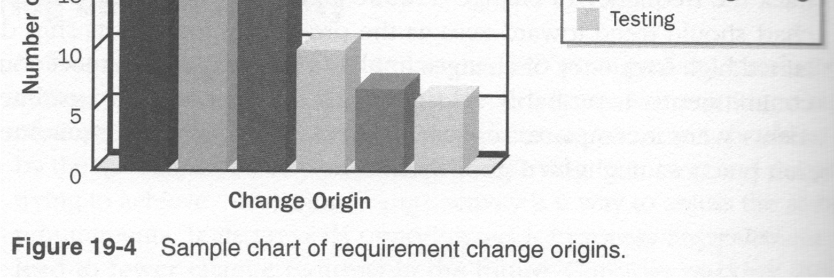
Where do changes come from?

Slide 11
Changing Requirements
All stakeholders want to change requirements, due to different reasons
Studies have shown that very significant percentage of delivered defects can be traced back to changing user requirements
A major issue in requirements engineering is the rate at which requirements change once the requirements phase has “officially” ended
This rate is on average 3% per month in the subsequent design phase, and should go down after that
This rate should come down to 1% per month during coding

Slide 12
Sources of Change
New business or market conditions dictate changes in product requirements or business rules
New customer needs demand modification of data produced by information systems, functionality delivered by products, or services delivered by computer-based system
Reorganization or business growth/downsizing causes changes in project priorities or software engineering team structure
Budgetary or scheduling constraints cause a redefinition of the system or product

Slide 13
Why All This Modification?
As time passes, all constituencies know more
About what they need
Which approach would be best
How to get it done and still make money
Statement of the fact: most changes are justified!

Slide 14
Managing Changing Requirements ???
Change management is concerned with the procedures, processes and standards which are used to manage changes to system requirements
Without formal change management, it is impossible to ensure that proposed changes support business goals
Following quality assurance mechanisms can limit the damage done by changing requirements
Formal change management procedures
State-of-the-art configuration control tools
Requirements reviews

Slide 15
Change Management Stages
Identified
problem
Problem analysis and
change specification
Change analysis and
costing
Change
implementation
Revised
requirements

Slide 16
Main Concerns in Requirements Management
Managing changes to agreed requirements
Managing the relationships between requirements
Managing the dependencies between the requirements document and other documents produced in the systems engineering process

Slide 17
CASE Tools for Requirements Management
Requirements management involves the collection, storage and maintenance of large amounts of information
There are now a number of CASE tools available which are specifically designed to support requirements management
Configuration management tools may be adapted for requirements engineering

Slide 18
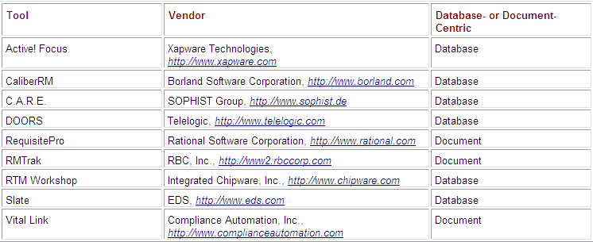
Requirement Management Tools

Slide 19
Benefits of using Requirement Management tools
Manage versions and changes
Store requirement attributes
Facilitate impact analysis
Track requirements status
Control access
Reuse requirements

Slide 20
Stable and Volatile Requirements
Requirements changes occur while the requirements are being elicited, analyzed and validated and after the system has gone into service
Some requirements are more stable, while others may be more subject to change than others
Stable requirements are concerned with the essence of a system and its application domain. They change more slowly than volatile requirements
Volatile requirements are specific to the instantiation of the system in a particular environment and for a particular customer
Volatility is usually measure by gathering statistics from RDMS(Requirement Data Management System)

Slide 21
Requirements Change Factors
Requirements errors, conflicts and inconsistencies
Evolving customer/end-user knowledge of the system
Technical, schedule or cost problems
Changing customer priorities
Environmental changes
Organizational changes

Slide 22
Requirements Errors, Conflicts and Inconsistencies
As requirements are analyzed and implemented, errors and inconsistencies emerge and must be corrected. These may be discovered during requirements analysis and validation or later in the development process

Slide 23
Evolving Customer/End-user Knowledge of the System
As requirements are developed, customers and end-users develop a better understanding of what they really require from a system
Technical, Schedule or Cost Problems
Problems may be encountered in implementing a requirement. It may be too expensive or take too long to implement certain requirements

Slide 24
Changing Customer Priorities
Customer priorities change during system development as a result of a changing business environment, the emergence of new competitors, staff changes, etc.
Environmental Changes
The environment in which the system is to be installed may change so that the system requirements have to change to maintain compatibility

Slide 25
Organizational Changes
The organization which intends to use the system may change its structure and processes resulting in new system requirements

Slide 26
Types of Volatile Requirements
Mutable requirements
Emergent requirements
Consequential requirements
Compatibility requirements

Slide 27
Mutable Requirements
These are requirements which change because of changes to the environment in which the system is operating
Emergent Requirements
These are requirements which cannot be completely defined when the system is specified but which emerge as the system is designed and implemented

Slide 28
Consequential Requirements
Requirements that result from the introduction of the computer system. Introducing the computer system may change the organization's processes and open up new ways of working which generate new system requirements.
Compatibility Requirements
These are requirements which depend on other equipment or processes

Slide 29
Requirement measurements and metrics
Measurement practices are used to obtain metrics for effectively managing requirements. Measurements can be used to perform analysis that are compared to benchmark values.
Was the RE staff adequately trained?
Was the team paying enough attention to RE process?
Were the requirements traceable?
Was the quality of products adequate?

Slide 30
Project metrics
Are used for day-to-day evaluation of project and to determine the completeness of an artifact or task.
Process, measurements and tools are mutually interdependent.
Without process, there could be no measurement, without measurement, project progress and quality can not be accessed and without tool support, taking measurements would be extremely time consuming

Slide 31
Quality Metrics
They measure quality of requirement artifacts but do not necessarily convey information about project progress.
Quality is measured against standards

Slide 32
Requirements Management
Project Management
– Setup schedules
– Risk Management
Estimation for each requirement
– Use your requirements model to sum up efforts to your needs
Most estimation is based on historical data

Slide 33
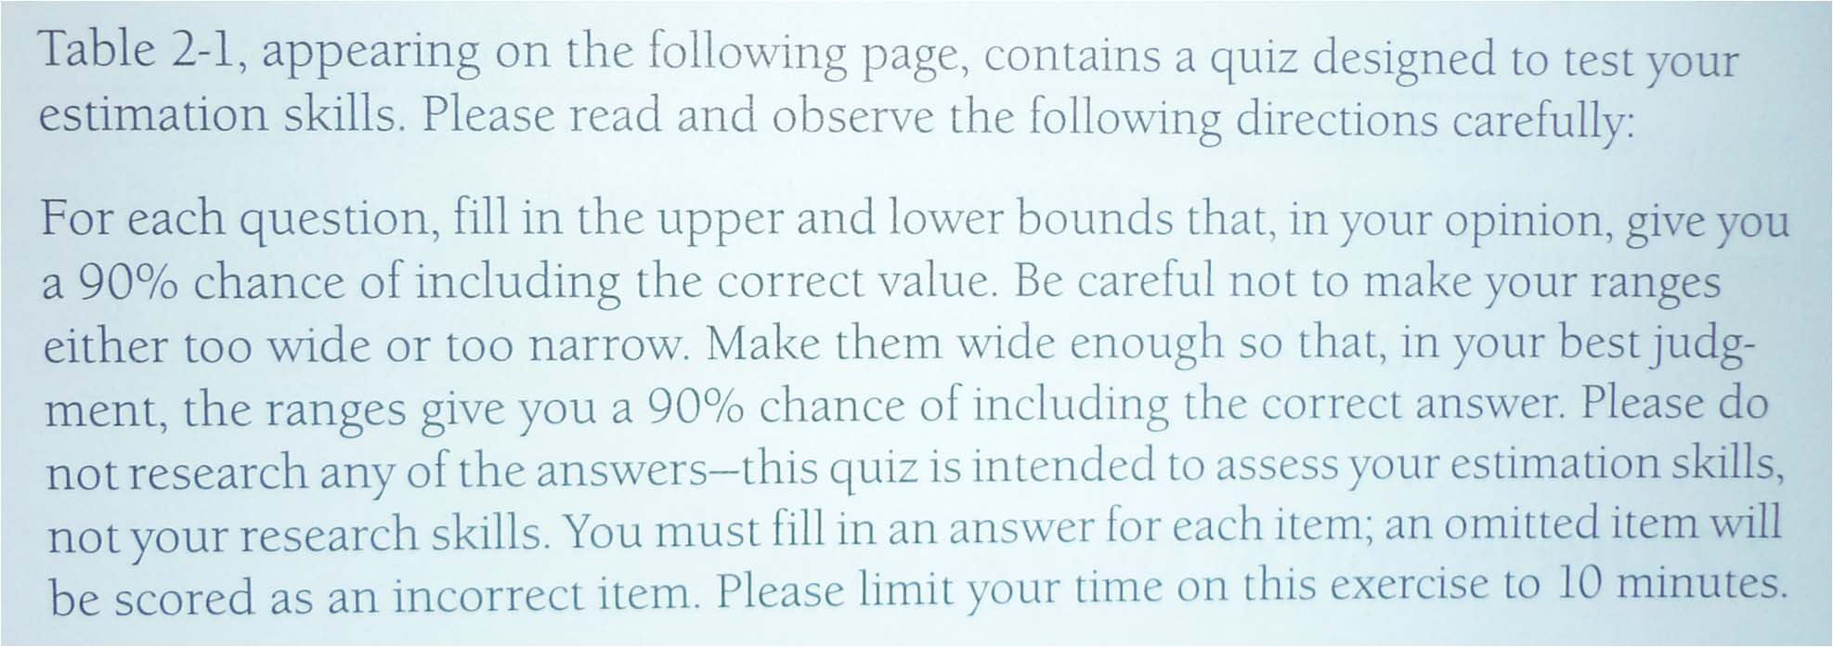
A Little Estimation Game
[McCo 2006]

Slide 34
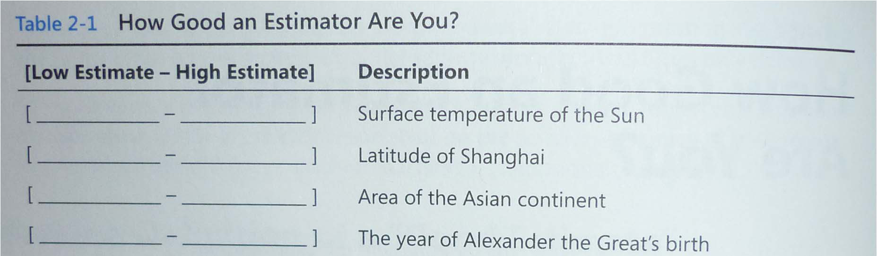
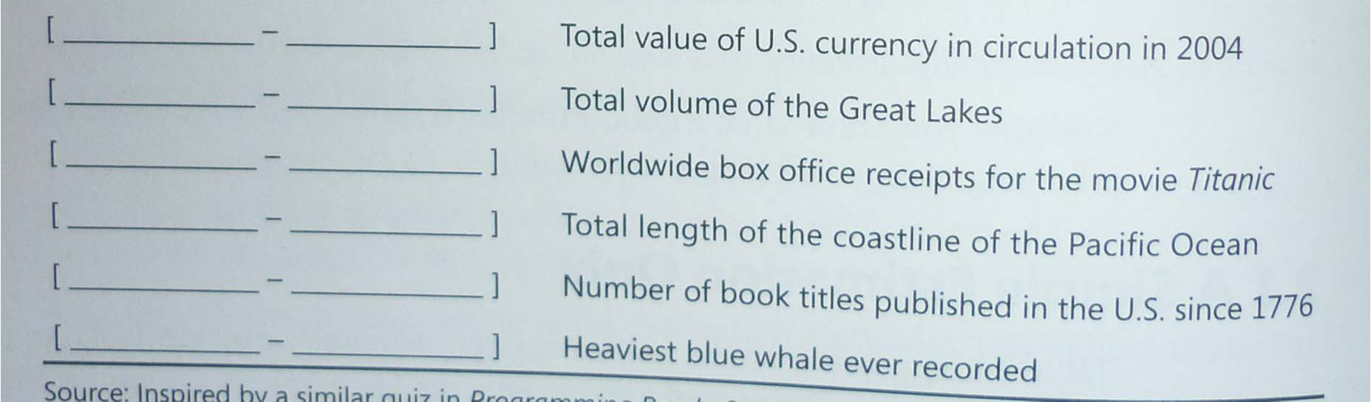
A Little Estimation Game

Slide 35
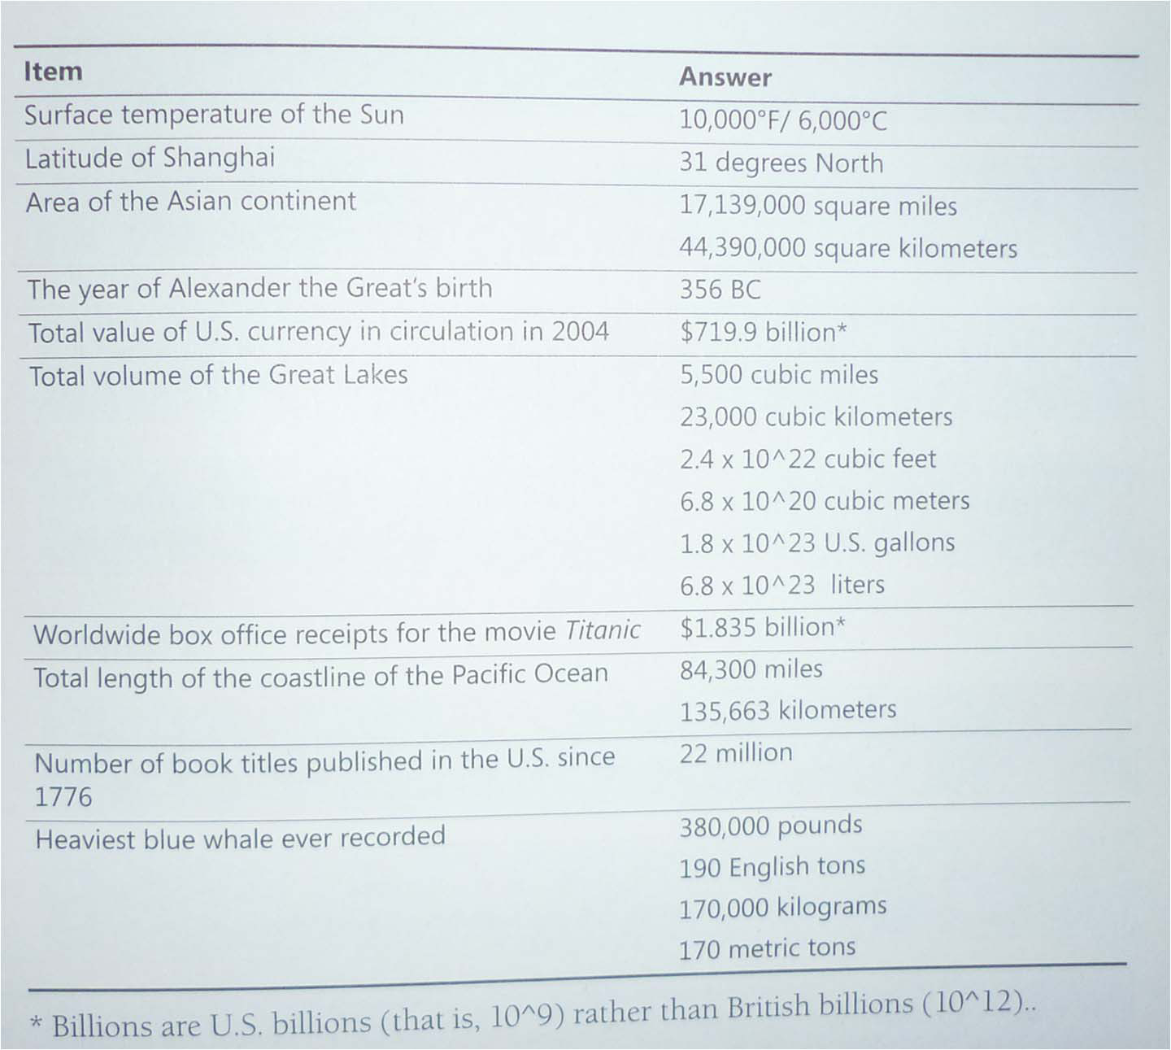

Slide 36
Requirements Identification
It is essential for requirements management that every requirement should have a unique identification
The most common approach is requirements numbering based on chapter/section in the requirements document
Following Techniques are used for Requirements Identification
Dynamic renumbering
Database record identification
Symbolic identification

Slide 37
Storing Requirements
Requirements have to be stored in such a way that they can be accessed easily and related to other system requirements
Requirement Storage Techniques may be:
In one or more word processor files
In a specially designed requirements database

Slide 38
Word Processor Documents: Advantages and Disadvantages
Requirements are all stored in the same place
It is easy to produce the final requirements document
Requirements traceability must be externally maintained
Search facilities are limited
Not possible to link requirements with proposed requirements changes
Not possible to have version control on individual requirements
No automated navigation from one requirement to another

Slide 39
Requirements Database Advantages and Disadvantages
Good query and navigation facilities
Support for change and version management
Readers may not have the software/skills to access the requirements database
The link between the database and the requirements document must be maintained

Slide 40
Requirements Database Choice Factors
The statement of requirements
The number of requirements
Teamwork, team distribution and computer support

Slide 41
Sources
Software Requirements, Second Edition by Karl E. Wiegers

